Slide 1

BroadVision One-to-One
Product Overview

Slide 2





7
8
9
4
5
6
1
2
3
Web Server
Other Access Methods
Open API
Interaction Manager
Observation Engine
Access Control Engine
Business
Manager
Content
Professional
Open API (CORBA)
One-to-One Applications
One-To-One
Commerce
One-To-One
Financial
One-To-One
Knowledge
My
Application
Open
API
Open
API
Command Centre
Content Manager
Profile
Manager
Matching
Agents
Notification
Engine
Design Centre
Publishing Centre
BroadVision
One-to-One Enterprise
System Manager
TX
Server
Workflow
Engine
Rules
Engine
One-To-One ToolsTM
Open API (CORBA)
Open Adapters for EBS Integration
Developer
Site
Manager
Enterprise
Systems
RDBMS

Slide 3


Slide 4
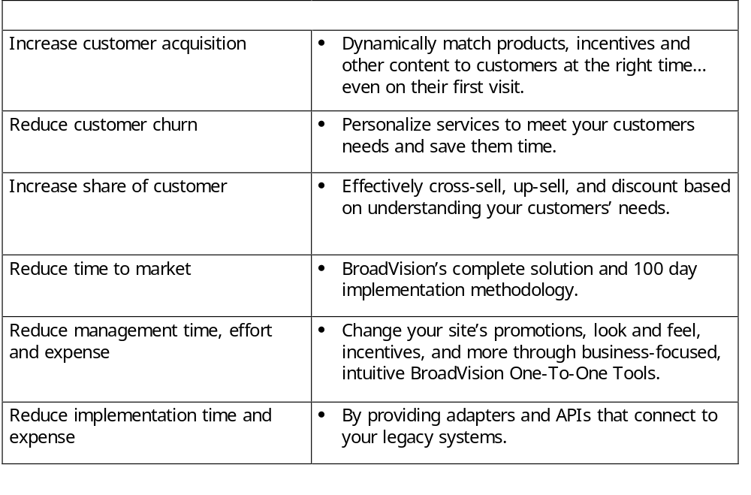
Commerce Benefits

Slide 5
Commerce Features
Personalisation
  Observed info
  Stated info (profile)
  Transaction info
  Matching (rules, ratings, collaborative filtering)
Shopping
  Anonymous & registered
  Persistent shopping cart
  Shopping lists- shared, personal
  Search- parametric, text, category
  Promotions, incentives
  Alerts- Web, email, fax, page
Transactions
  Pricing
  Shipping, handling, tax
  Payment processing
  Order mgmt/ fulfillment
  Order status
  Security
  APIs
Administration/ Tools
  Business rules
  Content adds, changes
  User/group adds, changes
  Reporting

Slide 6
Leading Personalisation Engine
Instant personalisation for anonymous and registered users in real time
  Sell effectively - even on the first visit
  Use observed, stated and transactional information
Cross sell, up-sell, incentives, target alerts
Collect and use customer information to build relationships and competitive barriers
Easier administration
  Fewer pages to manage- templates customised for each user

Slide 7
Comprehensive Shopping Engine
Browse
Search
  Parametric, category, text
List
  Personal or shared lists
Save items for next visit
  Persistent shopping cart, saved list
Dynamically target customers based on things users have or haven’t done
  E.g. remind them of complementary items
Shop for physical and electronic products

Slide 8
Sophisticated Transaction Engine
Complete transactions
  Pricing, shipping, tax, payment, inventory, order status and more
Payment integration
  Credit card, debit, purchase card
  CyberCash, Verifone, Cybersource
Adjustable pricing
  Fixed or percent discounts, tiered, contract etc.
Transaction integration with shopping
  E.g. suggestions based on previous purchases
Shopping phase
View/search
catalog
Select
product
Add to cart
or list
Buy goods
Transaction phase
Authorize
payment
Capture
order
Price order
Check
status
Settle
payment
Fulfill
order

Slide 9
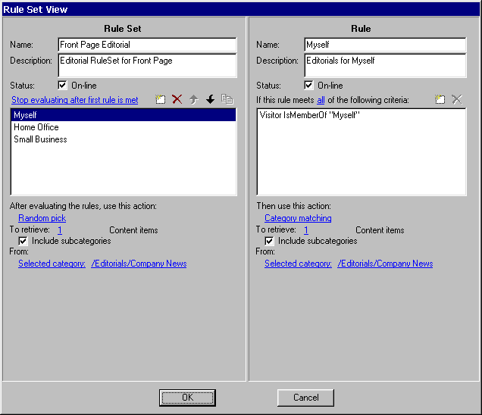
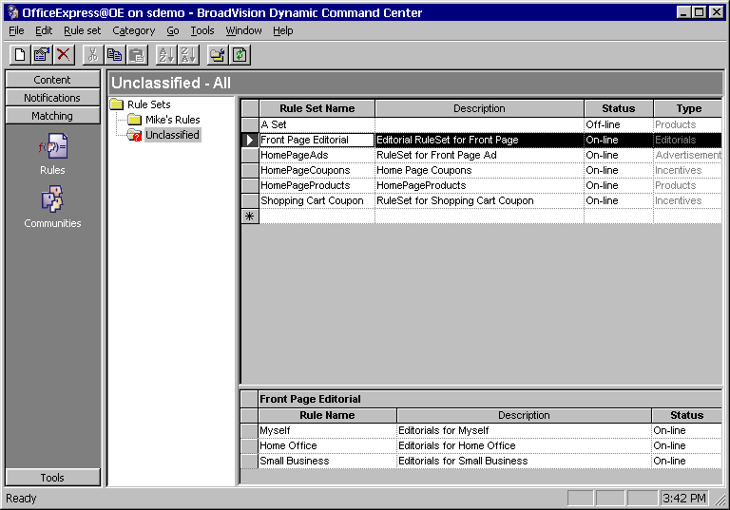
Intuitive BroadVision
One-To-One Tools
For business managers
  BroadVision One-To-One Command Center: Business managers can instantly change content, business rules and more.

Slide 10
Command Centre
Defines business-level behaviour
Designed for non-technical business managers
Basic content management
Create communities and rules
Send targeted e-mail
Schedule alerts (when content changes)
Business Managers

Slide 11
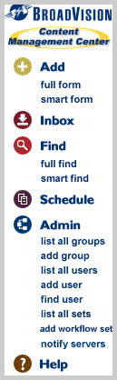
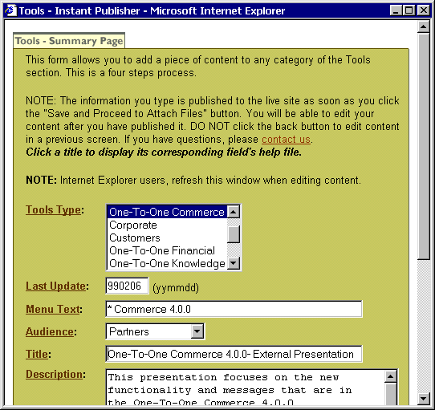
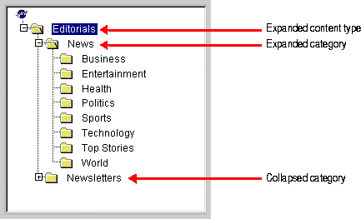
Publishing Tools
Publishing Center
Instant Publishers

Slide 12
Publishing Features
Manage and publish content;
  create, modify, and categorise content.
Access groups and privileges.
Workflow.
Personal and shared inboxes.
Preview content before publishing.
Attaching files to content.
Scheduling content for re-classification.
Notes:
The Content Management Centre is a configurable, web-based tool designed for all participants in the content management lifecycle, from full-time content professionals, who create, maintain, schedule, and manage content, to casual content contributors, who occasionally author and submit content. This flexibility makes the CMC an ideal content publishing tool for managing content on all internet, extranet, or intranet sites.
Increased Publishing Process Control - Content publishers can control the publishing process by granting and restricting publishing rights to individual users, subjecting content to a workflow process, and previewing it before it appears live on the site.
Increased Publishing Participation - All users, inside or outside of the organization, can submit and edit content using Smart forms, which are tailored and personalized to each users access and skill-level.

Slide 13
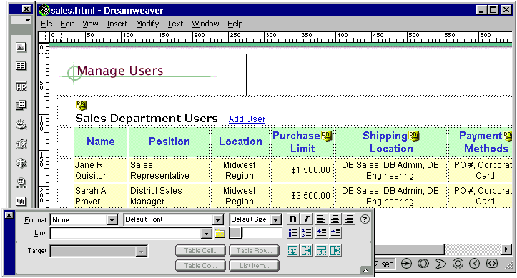
Design Center
For web designers
  BroadVision One-To-One Design Center: Create HTML templates with Macromedia Dreamweaver or other tool.

Slide 14
Multi-channel Support
Media
Set top box
(Broadcast)
Separated:
Presentation Mark-up language
Presentation Logic
Digital TV
kiosk
browser
Data
SDF
BiB/Open Online Server
Call Centre
HTML
SDF
Call Centre application
Web Server
Web Server
XML
Interaction Manager
Interaction Manager
Interaction Manager
SDF/JSP
HTML/JSP
XML/JSP
BroadVision Services
Shared:
Business Rules Users
Application Logic Content

Slide 15

One-To-One
Enterprise

Slide 16
Building Dynamic Pages
The building blocks of a dynamic page:
Templates & scriptlets
Business rules defined by Business Managers
Components for access to:
  Content, profile information, alerts, transactions
  Back-end system data (e.g. SAP, Baan)
7
8
9
4
5
6
1
2
3
Touch Points
BroadVision
Browser
httpd

Slide 17
Templates and Scriptlets
Static HTML/XML for layout and presentation
Server-side JavaScript for application logic
Component references for dynamic content & profile information
Template
Static HTML/XML
Scriptlets reference the components which generate the personalised content at run-time
Java applet / client-side JavaScript
Scriptlet
HTML
HTML
Scriptlet
JAVA
Scriptlet

Slide 18
Script Example
<%
  initSessionState();
  var username = Request.value("username");
  var password = Request.value("password");
  visitor = Session.visitorManager.newVisitor(username, password);
  if (accepted) {
  setCurrentVisitor(visitor);
  setCurrentService("MyBank");
  }
%>
<html><head><title>Broadway - Welcome Page</title></head>
<body bgcolor= "<%=bgColor%>” text="#15046F">
<b><font size=+2>Welcome <%= visitor.NAME %> </font></b>
Component
Glue Code
HTML & Script

Slide 19
Components
Interact with 1-1 Services using API to facilitate:
  database content provision
  user profile management
  integration with existing systems
Written in C++/Java
Can extend existing components
JavaScript means many sites need never write a new component

Slide 20
Components
My Application
Process
Visitor
Component 3
Session
Content
Component 2
Request
Matching
Component 1
Response
Observation
Wallet
Error handler
Search
Sales Rep
Logging
Alert
Incentives
System
Application
Commerce
Notes:
A visitor is data (some hard-coded) + profile attributes.
Content and matching interfaces simpler.
Observations recorded directly from scripts.
Logging available directly from scripts.
Built-in Error object for “continuable” error conditions.

Slide 21
Content Types
All content is held in the database (local or external)
Customisable existing content types
  Products Advertisements
  Editorials Incentives
  Discussion Groups Notifications
Create new content types:
  local or external database
  visible to the Command Centre for targeting
Master-detail relationships within content and profile enable rich data models

Slide 22
Notifications
Controlled from the Command Center
Target ‘bulk’ notifications to Communities
Trigger notifications (Alerts) based upon content updates
Notifications are dynamically created and personalised using scripts
Send notifications via e-mail or to web inbox
Add new delivery mechanisms, e.g. SMS messages
7
8
9
4
5
6
1
2
3

Slide 23
Notification Architecture
Message
Generation
Delivery
Type
Scheduler
Alerts
Poll notification jobs
Trigger Alerts
Process alert
plug-in and
generate
output
Generate from
Javascript
Deliver using
Inbox
Email
7
8
9
4
5
6
1
2
3
Touch Points

Slide 24
Observations
Record usage of content
Use observations for
  targeting
  reporting
Four major types of observation
  Saw User saw a link to content
  Selected User clicked on content to see more
  Chose User put content in shopping cart
  Bought User bought content

Slide 25
Internationalisation Support
Full end-to-end character set support for English, Japanese, Western European (Latin 1), Arabic, Traditional Chinese, Korean and Turkish
Translation of the Command Center
Full support for the Euro
  Euro or local currency as the base currency for EMU countries
  Euro conversion component
Notes:
1. Based on the internationalized product, our applications can be localized to many different languages. Supported languages: English, Western European, Japanese, Hebrew, Arabic, Traditional Chinese, Korean and Turkish.
2. With the localised version, business managers (DCC users) and content developers (VDC users) can use the applications in their native language. Menu bars, data, as well as documentation are all in local language (English, German, Japanese).
3. Contents and display items shown to visitors are also in the native language of choice.

Slide 26


Internationalisation Example
Business
Manager
Business
Manager
English
German
Web Visitor
German
Web
Server
BroadVision
One-To-One
German,
English
Content
English
Notes:
1. Based on the internationalized product, our applications can be localized to many different languages. Supported languages: English, Western European, Japanese, Hebrew, Arabic, Traditional Chinese, Korean and Turkish.
2. With the localised version, business managers (DCC users) and content developers (VDC users) can use the applications in their native language. Menu bars, data, as well as documentation are all in local language (English, German, Japanese).
3. Contents and display items shown to visitors are also in the native language of choice.

Slide 27
Personalisation Techniques
Personalization techniques
Agent-driven
User-driven
Site Control
User Control
Search
1. Rule-based matching
2. Matching Agent
7. Feature search
9. Alerts
10. Menu
Select
3. Feedback & Learning
4. Community Rating
8. Text search
5. E-mail
Targeting
6. Collaborative
Filtering

Slide 28
Rule-based Matching
Rules are of the form
  IF profile criteria / session criteria
  THEN show specified content
Entered in the Command Centre and stored in the Database
Rules referenced from scriptlets
Rules can be changed in real time

Slide 29
Matching Agent - Taxonomy
Present the user with content most relevant to them
Content classified against weighted descriptive attributes
User profiles themselves against the same attributes
Matching algorithm to determine best content fit

Slide 30

Functional Architecture
Command Centre
Presentation Layer
Business
Rules
Data Storage
Content Mgmt
Profiling
Matching
Transactions
Relational database
Existing business systems
Content
Web server and browser
Open Adapters/
DB Accessors
Interaction Manager

Slide 31
Technical Architecture
Verity
Index
Oracle
Sybase
Informix
SQL Server
Browser
Publishing
Center
Design
Center
Command
Center
HTTP
SSL
CORBA
BV
RDBMS
External
Data
Source
Page Script Files
WEB SERVER
RW, or
External
(NSAPI, ISAPI, CGI)
RogueWave
TCP/IP
IDL
IDL
Database
Session
Manager
Accessors
(CORBA)
JavaScript Pre-processor
User profile
E-mail
Existing
Systems
Complete
schema
targeting
JavaScript
Engine
Extensible
Community
Master/detail
Pre-defined/
Personal
Script, Content,
Rule Caches
relationships
user-defined
INTERACTION MANAGER
messages
Component Shared Libraries
NOTIFICATION MGR
Hidden
types
PROFILE MANAGER
PROFILE MANAGER
CONTENT MANAGER
CONTENT MANAGER
Alerts
Observation
System
Attributes
Extensible
Content,
Guest login
Master/detail
stock, etc.
Matching Engine
Assumed
relationships
User-define
IDL
IDL
IDL
Identities
Hierarchical
E-mail/alert
OPEN ADAPTERS
Access
Control (ACL)
Communities
Rules
daemons
IDL
IDL
IDL
IDL
CORBA

Slide 32
Commerce Architecture
DESIGN
CENTER
PUBLISHING
CENTER
COMMAND
CENTER
COMMERCE
TEMPLATES
COMMERCE
OBJECTS
3rd
Party
Software
INTERACTION
MANAGER
PROFILE
MANAGER
MATCHING
SERVER
CYBERCASH
ADAPTER
CONTENT
MANAGER
VERIFONE
ADAPTER
TAXWARE
ADAPTER
TRANSACTION
SERVER
DATA
ACCESSORS
N
E
T
WEB
SERVER
CORBA
RDBMS
OPERATING SYSTEM
HARDWARE PLATFORM

Slide 33
Development Environment
Presentation
Logic
Scripts +
HTML
Application
Logic
Scripts +
Components
Business
Logic
Rules

Slide 34
Platform Details
Operating System
  Solaris 2.5.1, 2.6
Databases
  Oracle 7.3.x, 8 (7.3 features)
  Sybase 11.x
  Informix 7.22.UC
  SQL Server
Web Server
  All Web servers with CGI
  Netscape Enterprise Server 2.0.1, 3.6.x. (NSAPI)
  Internet Information Server (ISAPI)
ORB
  IONA Orbix 2.2
Rogue Wave
  Tools.h++ 7.0.2
  DBTools.h++ 2.1.1
  Money.h++ 1.4.1
Languages
  Western European
  Japanese

Slide 35
BroadVision is… Open
Extensive published API
Multi-vendor support
  Solaris HP-UX
  Windows NT MS SQL Server
  Oracle Sybase
Detailed, extensible database schema
Data accessible to external systems
CORBA-based internal and external communication

Slide 36
BroadVision is…
Scalable and Resilient
Flexible system configuration allows tuning of the number of server processes for optimum CPU usage
CORBA-based internal communication allows seamless distribution across physical servers
Distribution allows redundancy to be built in for resilience
500 man-years of product investment

Slide 37
Scalability
Start with a simple configuration
httpd
httpd
httpd
imgr
imgr
imgr
Flexible system configuration allows number of server processed to be tuned to make maximum use of CPU
When web throughput is the bottleneck, add web servers and interaction managers
BV
CORBA allows seamless distribution of processes across physical servers when processing power becomes the bottleneck
When communication with the database and back end systems are the bottleneck, add BV services

Slide 38
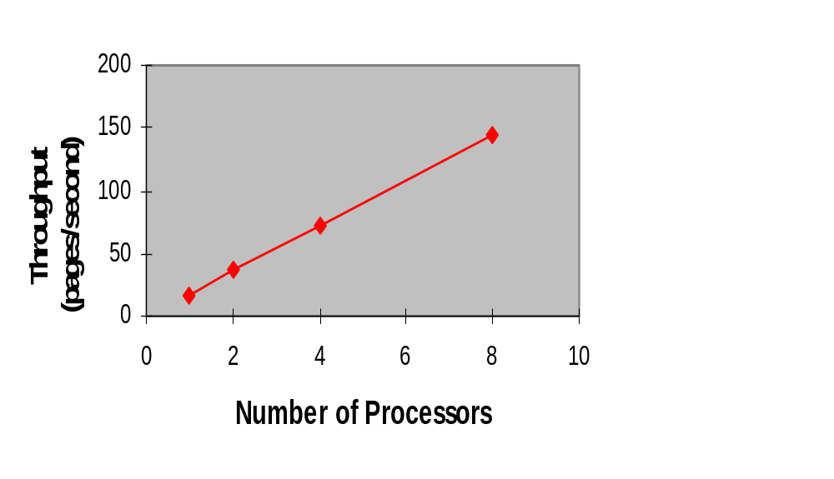
Scalability

Slide 39


BroadVision is… Secure
Firewall
SSL
Encryption
One-To-One
System
Browser
Secure
Web
Server
Authentication
Login/Password
Cookies
Digital Certificates
LDAP
Data Encryption
Notes:
* Since we reside behing the firewall, we can support any authentication method you want to use. We have customers that use login & password with 128 bit SSL, cookies, and digital certificates.
* Liberty Financial and Argentaria both use digital certificates to authenticate their customers. They act as certificate authorities and manage the certificates themselves.
* BroadVision uses the RSA Bsafe libraries for encryption of passwords and credit card information internally in our application.
* We work with a number of best-in-class security partners listed here.

Slide 40
BroadVision is… Extensible
Extensible database schema for user profile, products, etc
Components to add new functionality
Existing components can be reused through subclassing
CORBA-based Open Adapters for integration with existing systems

Slide 41
BroadVision is… Fast
Optimised to give fast response times
Achieved by using distributed architecture
Use of ‘best of breed’ components give best performance
Sun Ultra 1 will deliver with approx 50,000 dynamic pages per hour.
Content and template caches for maximum performance

Slide 42
Caching
Browser
Interaction
Manager
1:1
Services
HTTP
Server
NSAPI
RDBMS
Open Adapters
External
Business
Systems
Application Center
CORBA
Web
Server
Access
Dynamic
Page
Generation
1
2
3
Value-Add
4
Database/EBS Access
1: 20 ms 2: 200 ms 3: 20ms 4: 600ms
Static Page: 1
Dynamic Page - custom solution: 1+2+3+4
Dynamic Web Page - One-To-One: 1+2+3

Slide 43

Transaction
Overview

Slide 44
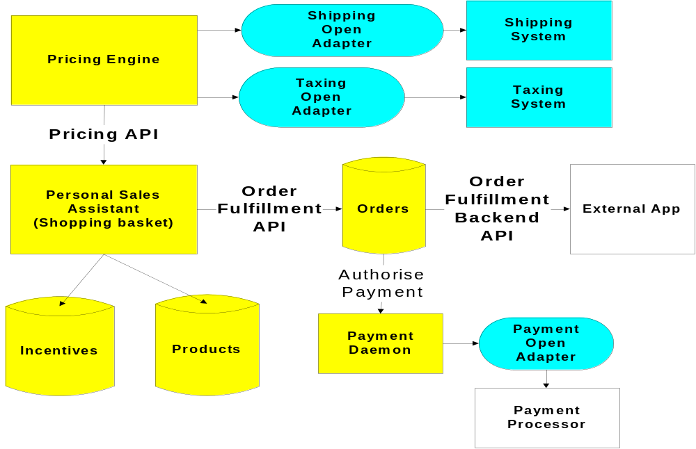
Robust Transaction Engine

Slide 45
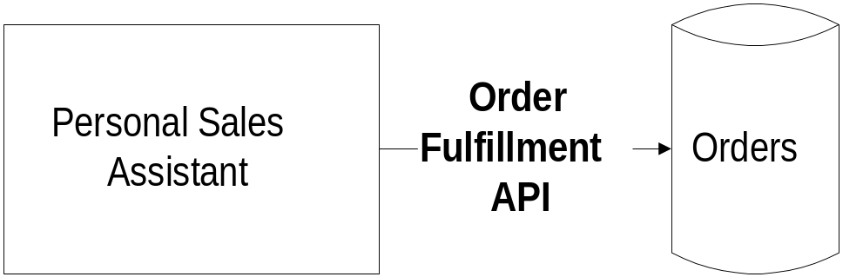
Order Fulfillment API
Converts shopping cart items into orders within the BV order database.
Handles:
  Order creation
  Query
  Coupon management

Slide 46
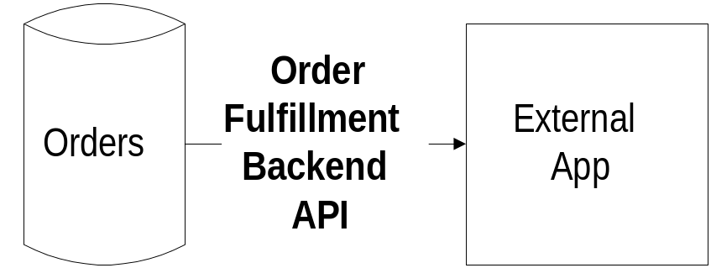
Order Fulfillment API
Integrates external order management system with One-To-One Commerce.
Handles:
  Order queries
  Returns
  Cancellations
  Complete and partial fulfillment
  Order status

Slide 47
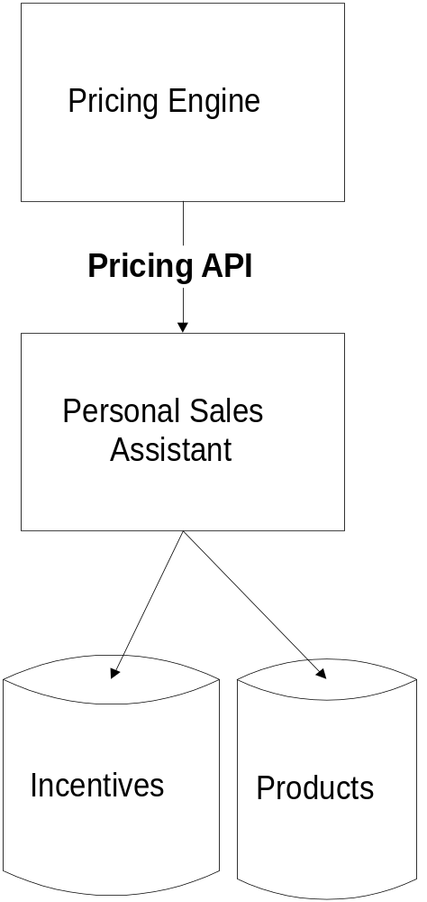
Pricing API
Calculates prices internally or integrates with external pricing system.
Handles:
  Fixed, tiered pricing
  Discounts: absolute, percentage, related product purchases
  Coupons, sale prices
  Integrates with external pricing sources such as ERP, configurator

Slide 48
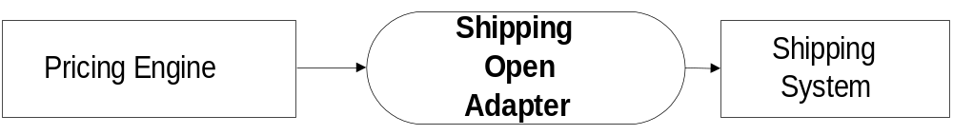
Shipping API
Calculates shipping internally or integrates with external shipping system.
Handles:
  By weight, cost, flat rate or # of products
  Shipping rate or table lookup
  Web-based shipping editor
  Open to external shipping systems, including UPS, FedEx, DHL, Tandata, etc.

Slide 49
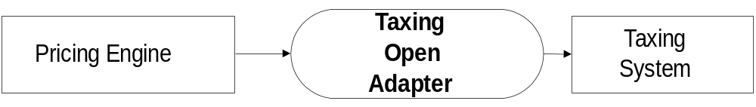
Taxing API
Computes taxes internally or integrates with external tax system.
Handles:
  Tax calculations by item or by order
  By weight, cost, flat rate or number of products
  Out-of-the-box integration with Taxware
  Integrates with other taxing systems

Slide 50
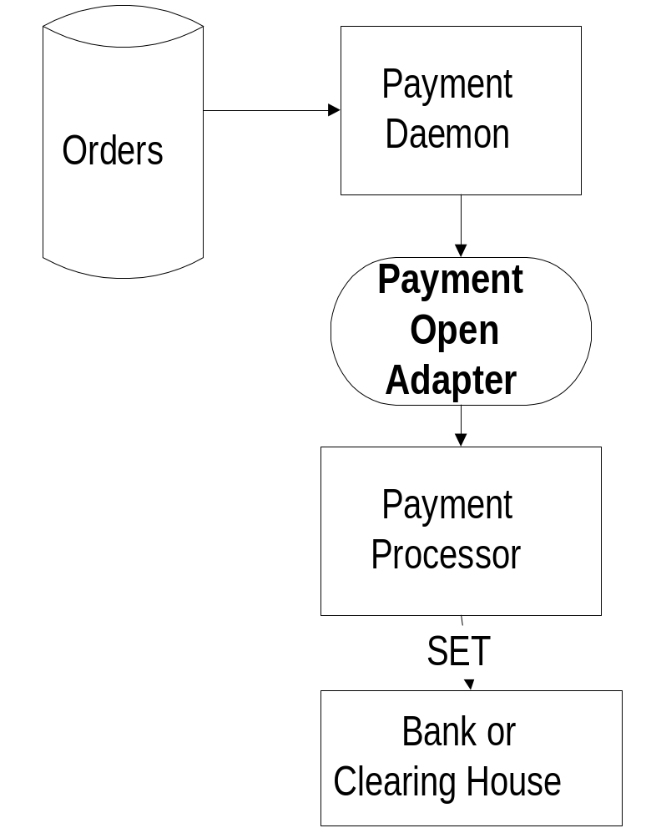
Payment API
Comprehensive payment system integrates with external systems.
Handles:
  Authorization, settlement
  Adjustments, returns
  Out-of-the-box integration with CyberSource, CyberCash, Verifone
  Integration with external systems such as CAFIS, Brokat Payline, Visanet

Slide 51
Integration
Overview

Slide 52
External System Integration
Content
Sources
Web Utilities
Search
Collaborative
Filtering
Security
Documentum
Lotus Notes
BroadVision
Back Office
Front Office
ERP
Payment
Shipping, Taxing
Billing
Middleware
Configurators
Call Center
CIS*
SFA*

Slide 53
Legacy Integration
Approaches
  1. Application API
  2. Middleware
  3. EDI
  4. FTP/EMail
Orders, Returns, Cancellations
One-To-One
External
Business
System
Status, Pricing, Inventory

Slide 54
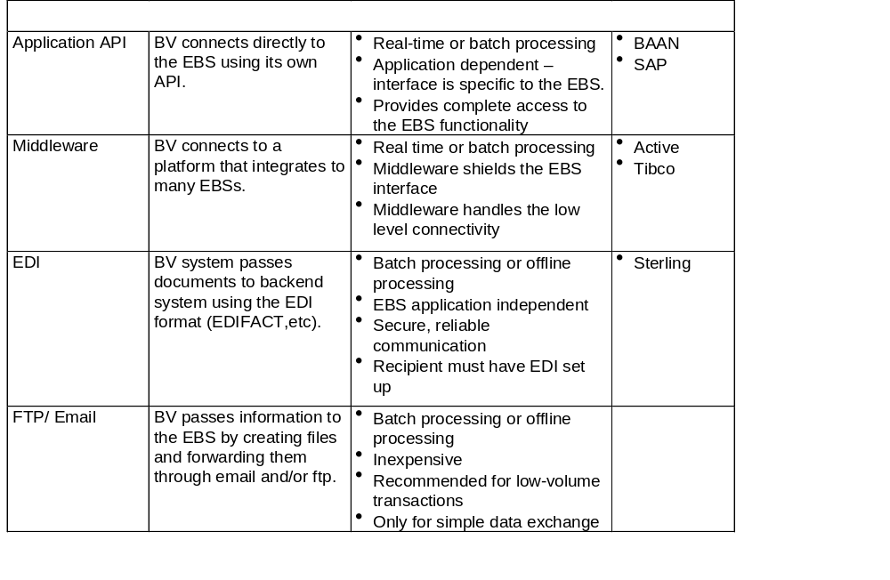
Legacy Integration

Slide 55
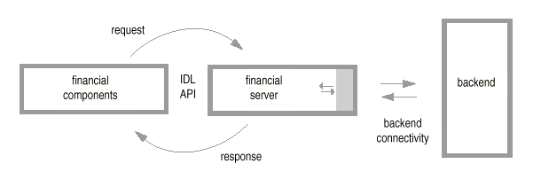
Example Open Adaptor

Slide 56
Q & A..

